Slide 1
About me
Name - Harsh Garg.
Batch Code – JP32S3.
Qualification – B.tech(ECE) from Dr. Abdul Kalam Technical University.
Skills - Core Java.
Under the Guidance of:
-Saurabh GuptaBhaya.

Slide 2
Content of Presentation
Agenda.
Technology.
Problem Statements #Task 1,
#Task2,
#Task3.
Application Flow.
Key Feature.
MySQL Script.
Diagram.

Slide 3


JUKEBOX Project by: -Harsh Garg

Slide 4
Agenda
I developed a Java based Application Where We can play the music, searched the music based on different categorize as well as we can create own playlist.

Slide 5




Technology used
Core Java, Java Database Connectivity(JDBC),Maven, MySQL

Slide 6
Problem Statement #Task-1
Jukebox should display all song.
Must be searched based on different categorize like Genre, Artist Name as well as Song Name.
It should be sorted based on Artist Name.

Slide 7
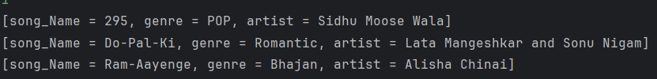
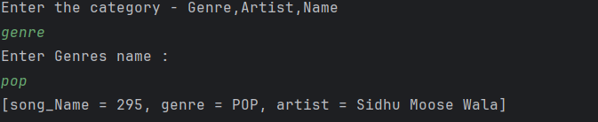

#Task-1 Snip chart

Slide 8


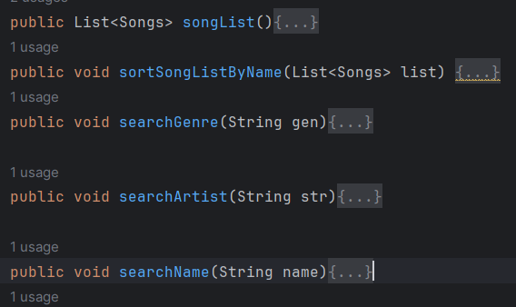
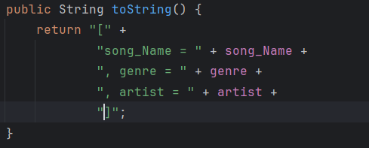
Application Flow - #Task1
Juke_BoxApp.
MenuOperation
Jukebox Service.
Format.

Slide 9
Problem Statement #Task-2
User should able to create playlist.
Add song into the playlist.
View Content of Playlist.

Slide 10
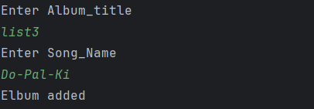
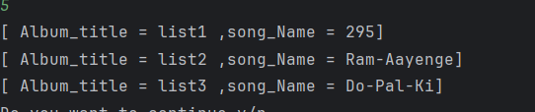
#Task-2 Snip chart

Slide 11

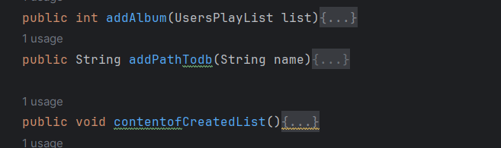
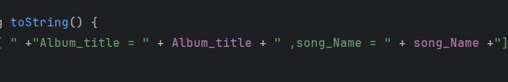
Application Flow - #Task2
Juke_BoxApp.
MenuOperation.
JukeBox Service.
Format.

Slide 12
Problem Statement #Task-3
User Able play song.
Display all song with name , genre, and artist name.
User able to play, stop, reset and quit.

Slide 13
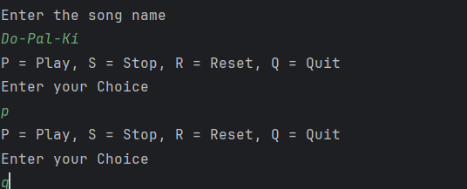
#Task-3 View chart

Slide 14

Application Flow - #Task3
Juke_BoxApp.
MenuOperation.
PlayToSong.

Slide 15
Key Features of the Project
JDBC- Jdbc stands for java Database Connectivity. It is a Java-based API that that allows java applications to interact with relational database.
Key component of JDBC – Driver Manager, JDBC DRIVER, Connection and Statement(Statement, PreparedStatement), Resultset.
Audio Input Stream - It is Java Sound API , In java Javax.sound.sampled Package provides classes and interface for working with audio.
MySQL- it is an open source relational Database management System that is widely used for management and storing data.

Slide 16
Script of MySQL
CREATE DATABASE Juke_box;use Juke_box;CREATE TABLE Catalog( song_Id INT PRIMARY KEY, song_Name VARCHAR(200) unique, artist_Name VARCHAR(100), album_Name VARCHAR(125), genre_Name VARCHAR(125), file_Path VARCHAR(300));
INSERT INTO Catalog(song_Id,song_Name,artist_Name,album_Name,genre_Name,file_Path)
VALUES(101,"295","Sidhu Moose Wala","The Kidd","POP","G:\\Juke_Box\\src\\main\\resources\\295.wav"),
(102,"Do-Pal-Ki","Lata Mangeshkar and Sonu Nigam","Veer-Zaara","Romantic","G:\\Juke_Box\\src\\main\\resources\\Do-Pal-Ki.wav"),
(103,"Ram-Aayenge","Alisha Chinai","Made in India","Bhajan","G:\\Juke_Box\\src\\main\\resources\\Ram-Aayenge.wav");CREATE TABLE User_Playlist(Playlist_Id INT PRIMARY KEY AUTO_INCREMENT,Album_title VARCHAR(100) Unique,song_Name VARCHAR(100) unique,Song_Path Varchar(300) unique);

Slide 17
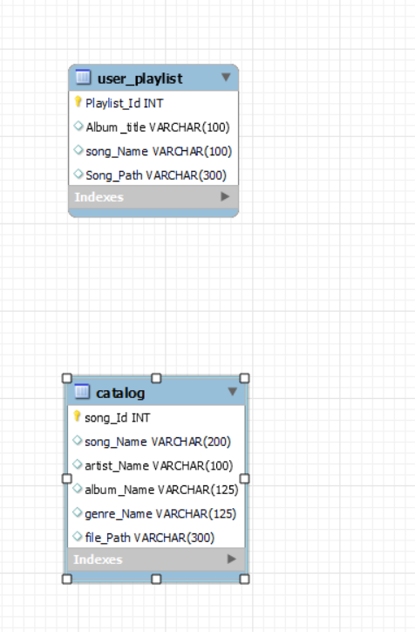
Diagram

Slide 18
Thank You

